Slide 1

T.E. (COMPUTER ENGINEERING)
2022-23(Semester V)
DEPARTMENT OF COMPUTER SCIENCE AND ENGINEERING
Savitribai Phule Pune University
Genba Sopanrao Moze Trusts
Parvatibai Genba Moze College of Engineering,
Wagholi, Pune - 412207

Slide 2
Presentation on Seminar topic entitled
Edge Computing Technology Enablers:
A Systematic Lecture Study
PRESENTED BY
Bhakti Kushabhau Gotarne.
Roll No.:25
UNDER THE GUIDANCE OF
Prof. Pramod Dhamdhere.

Slide 3
Contents:
Introduction
Related Surveys
EC Evolution History
EC Fundamentals
EC Enabling Tchnologies
EC Applications & Use cases
Future Work
Conclusion

Slide 4
INTRODUCTION
In recent years, the number of connected devices has grown tremendously, causing congestion issues that push to consider handling more data at the network’s Edge.
In addition to those network impracticability constraints, EC promises to provide an excellent service (latency, throughput) that will encourage the evolution of this revolutionary paradigm.
In this effort, I present a survey on edge computing, beginning with an explanation of the novel computing concept and how EC can meet the growing demand for computing and memory resources with low latency communications, as well as how EC can solve the rising privacy problems associated with processing data at the cloud level Nevertheless, EC is associated with several innovative technologies, notably the Internet of Things (IoT).
Along with the fifth-generation networks (5g), EC is a vital solution for enabling the polarization of connected objects. Moreover, artificial intelligence (AI) and machine learning (ML) technologies are becoming more prevalent in novel applications.

Slide 5
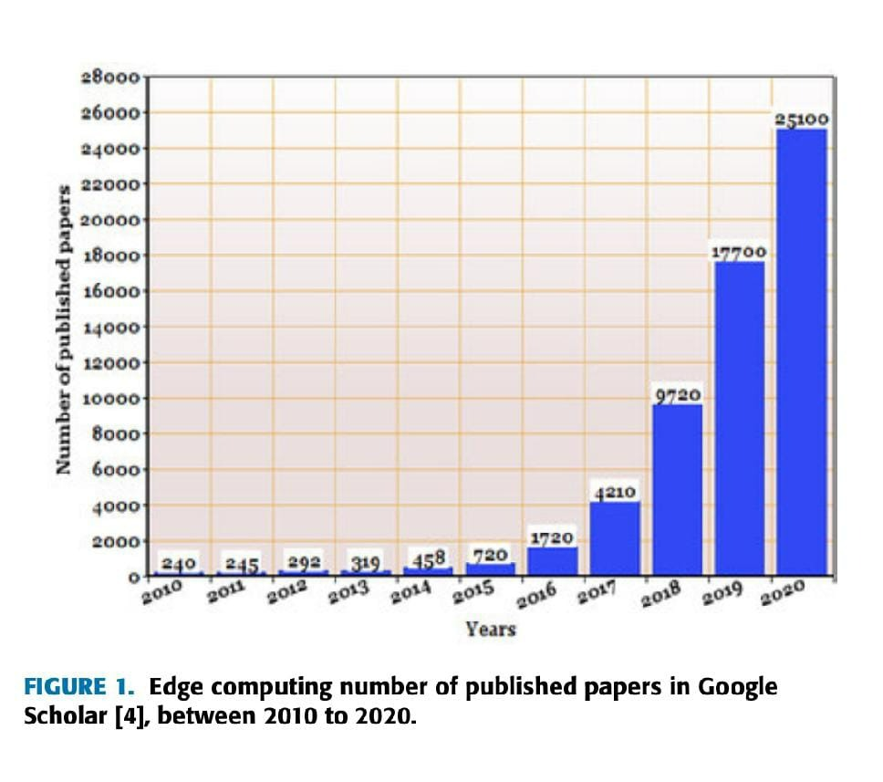

Slide 6
RELATED SERVEYS
In the past few years, several EC surveys have been proposed.
Table II outlines the most important ones of these surveys, as well as the taxonomy of the topics they covered, which includes the EC Concept and History, EC Architecture, EC Fundamentals, Enabling Technologies, Applications, and EC Challenges & Future Concerns. Further, based on the published time and the main focus of the surveys, we divided the Edge Computing literature surveys into three groups.
Along with that, the road map of Edge computing started to expand, and its branches grew tremendously, to a point where EC began to converge and touch other related technologies (e,g, IoT, 5G, EI, etc.).

Slide 7
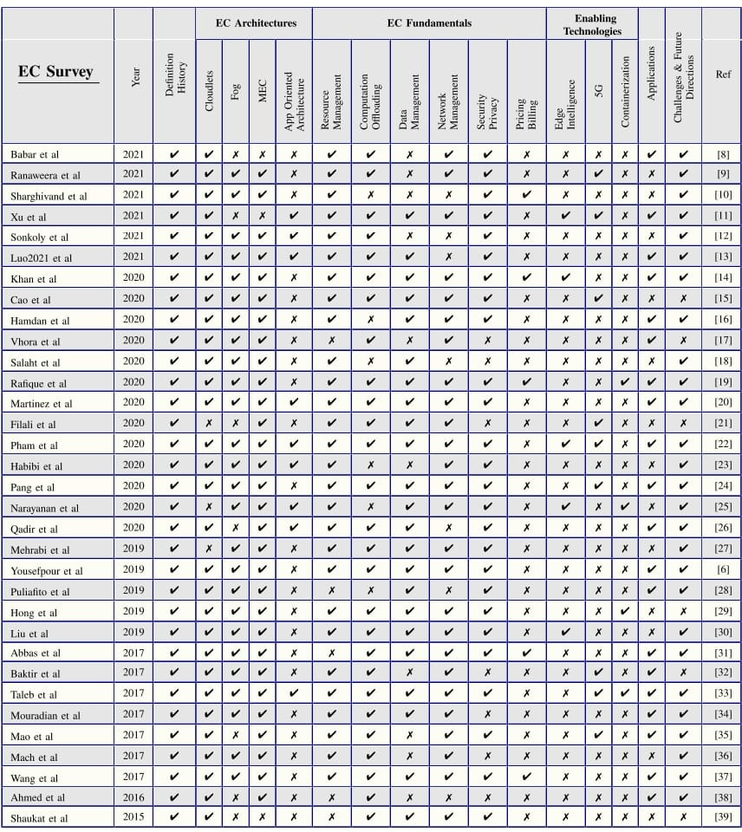

Slide 8
EC: DEFINITION
There is no standard definition of EC, but many researchers view EC as an abstracted computing paradigm that aims to move cloud computing and storage capabilities to the network edge near where the end-users reside.
B. WHY EDGE COMPUTING?
There are numerous benefits and drawbacks that drove the need for a new computing paradigm known as Edge Computing, which we divide into two categories: QoS and necessity.
C. CONTRIBUTION:
In our work, we drew inspiration from the excellent EC systematic mapping study built-in , recognizing the need to fill the gap and produce a systematic lecture study on the subject. We observe a lack of works covering EC technology enablers since the few works covering EC enabling technologies focused only on one enabling technology of EC.

Slide 9
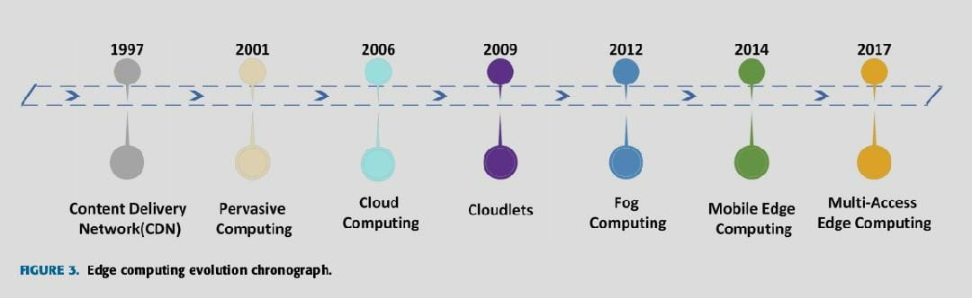
HISTORY AND ARCHITECTURES:
THE EVOLUTION OF EDGE COMPUTING
The evolution of this computing paradigm has been carried through several stages since 1997. As shown in Fig. 3, each step influenced the concept directly or indirectly and changed the way EC is conceived.
CONTENT DELIVERY NETWORKS (CDNs)
CLOUDLETS
FOG COMPUTING
MOBILE EDGE COMPUTING
MULTI-ACCESS EDGE COMPUTING

Slide 10
EDGE COMPUTING FUNDAMENTALS
A. RESOURCE MANAGEMENT
The task of resource management is the act of providing the right and comfortable scale of edge resources (CPU, memory, I/O) to any requesting edge application while also optimizing the usage of the exciting pool of resources.
B. COMPUTATION OFFLOADING
Computation offloading is a branch in computer science that deals with whether to run a process locally or send it to be processed by a commodity server outside. Computational offloading gained popularity with the rise of mobile cloud computing.
DATA MANAGEMENT
The act of acquiring, storing, distributing, and using data is referred to as data management. Data management aims to assist edge nodes in placing, sharing, analyzing, and retrieving data from one another to make decisions and take actions that maximize their overall utility while minimizing the end-to-end latency.

Slide 11
D. NETWORK MANAGEMENT
Network management encapsulates the advancements made in network infrastructure and architectures that adapt the network parameters to the new computing paradigm. The network management function focuses on monitoring, analyzing, and dynamically adjusting network status as needed.
E. SECURITY & PRIVACY
Since the network edge environment is much different, EC security issues are considered one of its biggest challenges. In CC, data is stored in multiple large data centers, which are very well protected physically, with many guards, fences, and security protocols.

Slide 12
ENABLING TECHNOLOGIES
EDGE INTELLIGENCE
B. 5G AND ITS EMPOWERING TECHNOLOGIES
MIMO
IRS (INTELLIGENT REFLECTING SURFACES)
5G OPTIMIZATION OF COMMUNICATION RESOURCES
NETWORK SLICING
6G
C. VIRTUALISATION, CONTAINERISATION
D. THE MOVE TOWARD FUNCTION AS A SERVICE (FaaS)

Slide 13
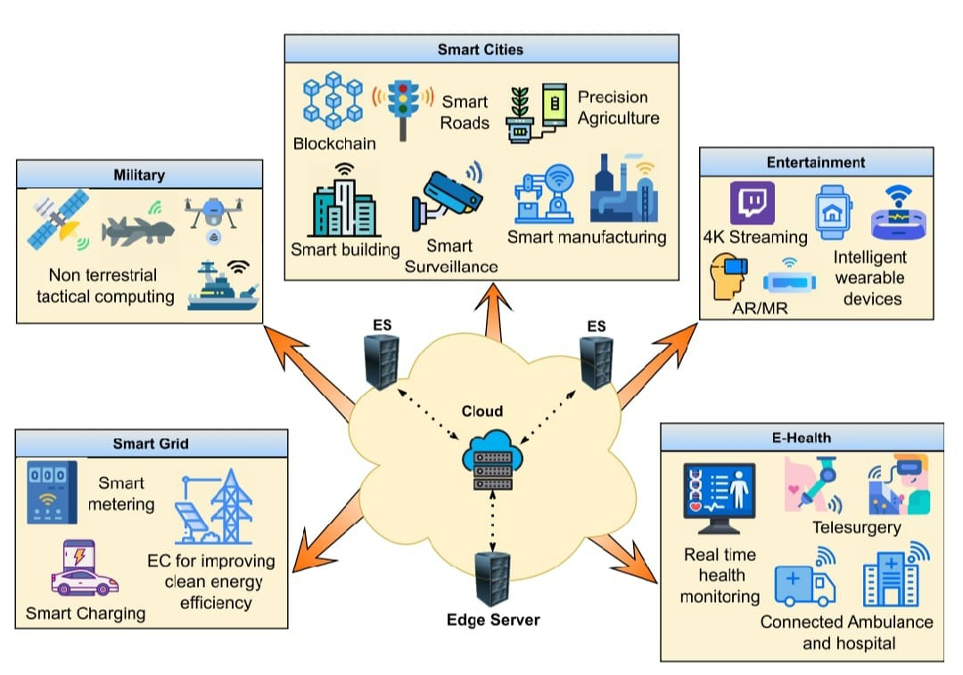
EDGE COMPUTING APPLICATIONS
SMART CITIES
Intelligent and connected cities are the image of our near future. Smart cities encompass a wide range of subdomains, including smart buildings, smart farms, smart roads, smart banks (Blockchain), and so forth.

Slide 14
E-HEALTH
By this century, electronic and information systems had already infiltrated the health sector, resulting in what we now call ‘‘e-Health.’’ EC is here to benefit e-health in a variety of ways, including medical records storage, dealing with privacy concerns, and coping with long retrieval delays from the cloud.
ENTERTAINMENT
There is no doubt that edge computing, in conjunction with 5G networks, will transform the gaming experience, particularly VR and AR games. The two criteria gamers despise the most are higher pings caused by high latency and poor FPS linked to low computing resources.
MILITARY & SPACE
A trend toward edge computing is a trend toward Tactical Edge Computing. Data cannot be backhauled to a central office in military operations because network infrastructure is one of the first tactical targets in a war, rendering the Cloud, fog, or MEC non-existent or out of service.

Slide 15
EDGE COMPUTING CHALLENGES
AND FUTURE CONCERNS
GREEN ENERGY
Climate change is one of the most pressing issues of the current decade. Climate change has compelled the globe to rely more on clean and sustainable energy. Although EC promises to reduce energy consumption pushed by cloud data centres, there is an increasing need for powering ES with clean energy and harvested energy approaches.
B. STANDARDIZATION
Edge Computing has emerged as a compelling and vital paradigm for industry and research. Several standardization institutions have put up a lot of effort to create recommendations and references on how to integrate EC either from the cloud-Edge side or from the MEC-5g standards network side. In terms of cloud architectures, the International Organization for Standardization (ISO) and the International Electrotechnical Commission (IEC) have put in a lot of work to define Cloud/Edge technical architectures, software platforms, virtual machine and container management, and orchestration.

Slide 16
CONCLUSION
The world is undergoing a massive shift toward digital services. As a result, computing and memory resources are in high demand. Furthermore, novel applications like smart cities, e-health, smart grid, and others require resources (computing & memory) with low latency services and a stable network free of security and privacy issues. EC has emerged to provide all of this. We presented a survey on the evolution and construction of this computing paradigm as part of this work. We discussed how related technologies such as 5G, Edge Intelligence, and containerization had pushed the evolution toward keeping and handling data at the Edge. Finally, we investigated how EC will respond to future concerns such as green energy and standardization.

Slide 17
THANK YOU!!!

